Slide 1

Project
DC Motor Controller Using FPGA with Interfacing of VGA
Workshop on reconfigurable computing (ECE365)
Under guidance of :- Dr. Sobhit Saxena
Professor (VLSI)
Best faculty of year(2023-2024)
Presented by:-
Jay Khaple (12011859)

Slide 2
Table of contents
Introduction
Block Diagram
Steps for implementation
Motor controller ckt
Vga Interfacing
Conclusion

Slide 3
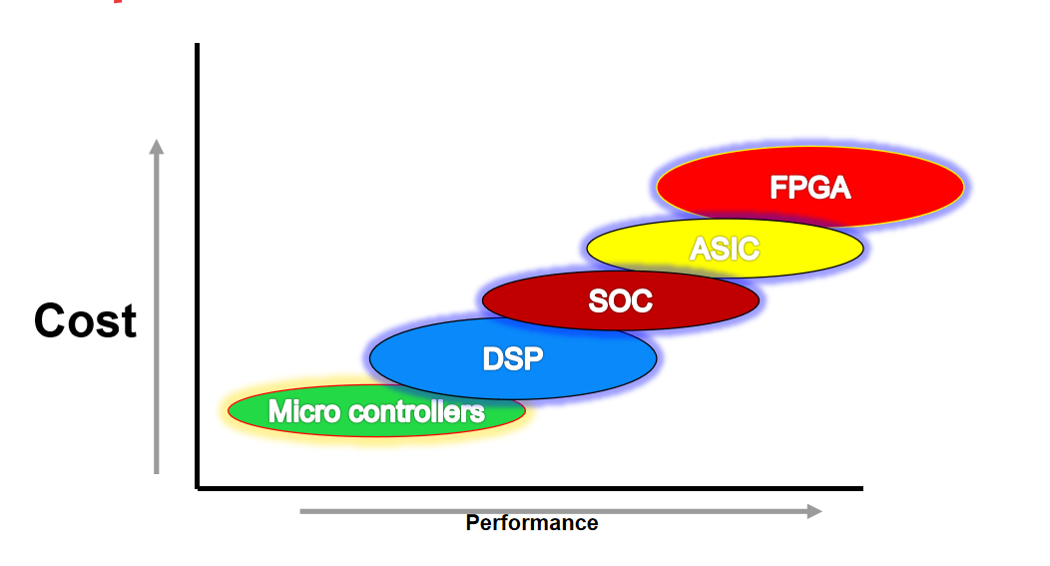
Introduction What is FPGA?
FPGA stands for Field Programmable Gate Array. It's like a blank canvas for electronic circuits, allowing you to create custom designs without physically manufacturing a new chip.

Slide 4
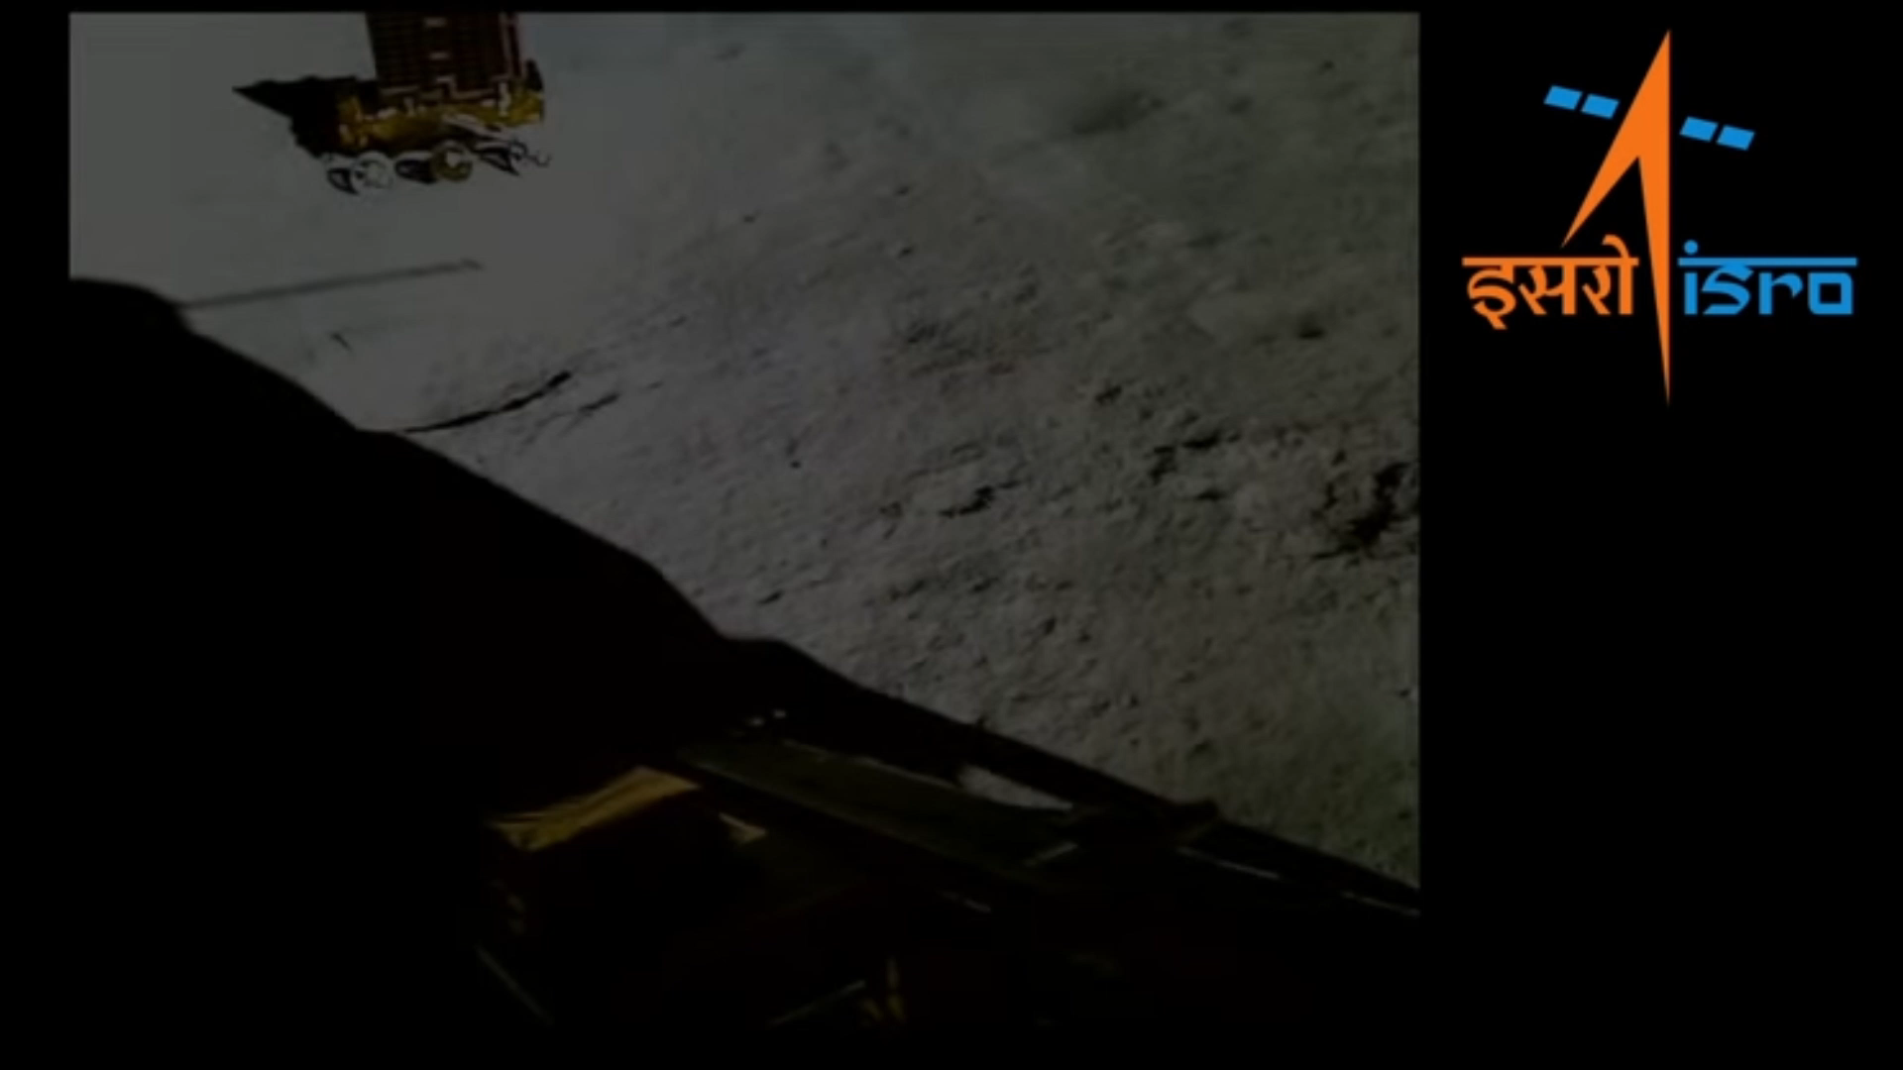
What exactly our project is all about????
To control:-
Speed of motor
Direction of motor

Slide 5
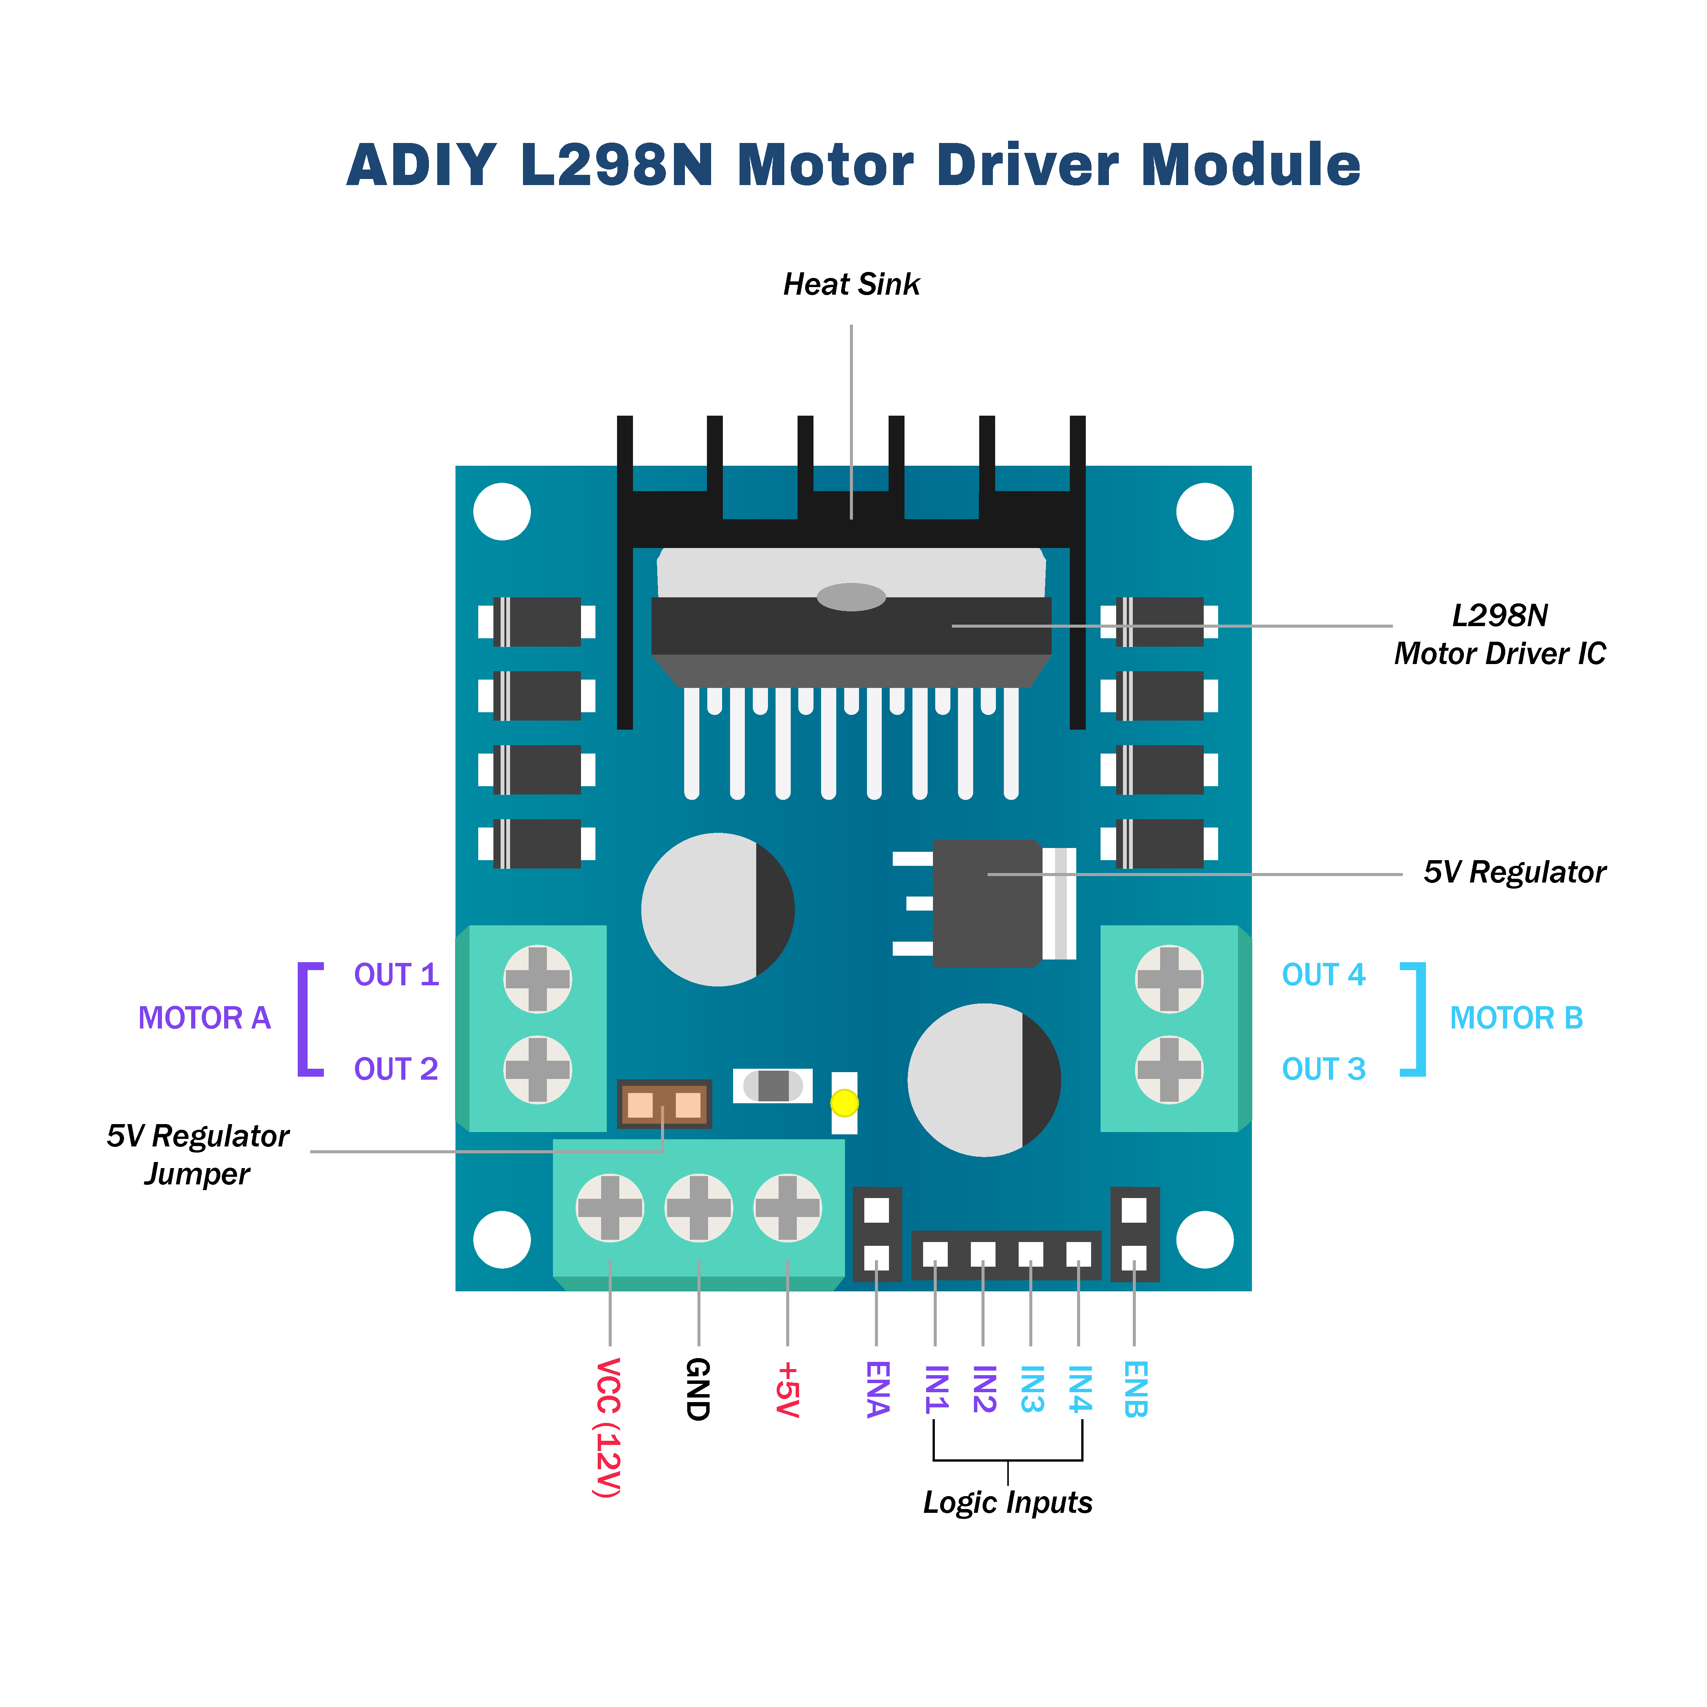

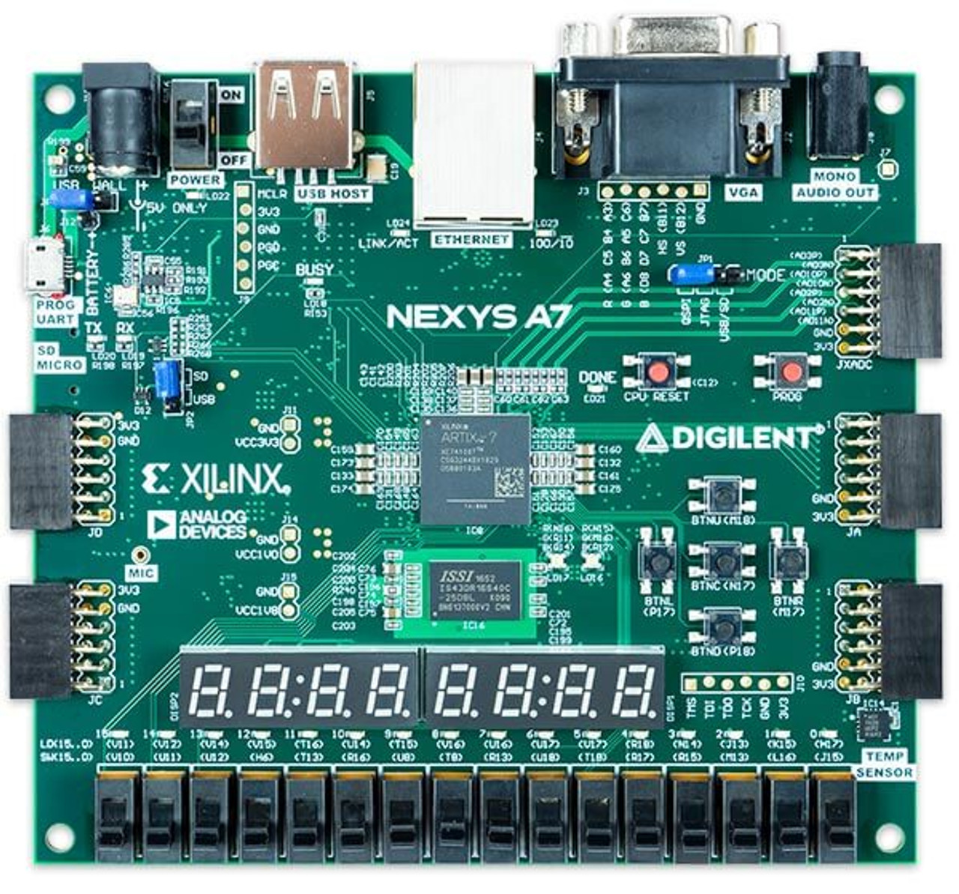



What Hardware are we using??
L289N
9v DC motor
Nexys 4 FPGA
Monitor

Slide 6
(On/off) && (Direction) && (5 gears)
Gear 5
Gear 4
Gear 3
Gear 2
Gear 1
Direction
On/Off

Slide 7
Motor Driver used :- L298N
Motor Supply Voltage (Maximum): 46V
Motor Supply Current (Maximum): 2A
Logic Voltage: -0.3 to 7 V

Slide 8
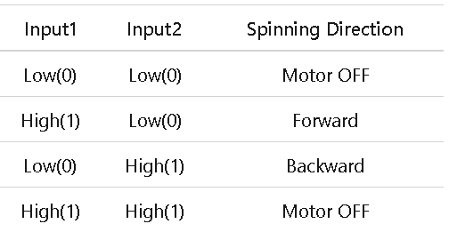
Motor Driver used :- L298N

Slide 9
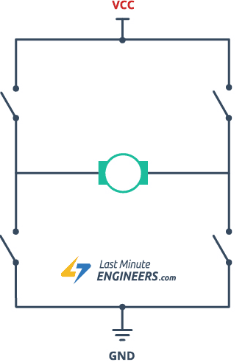
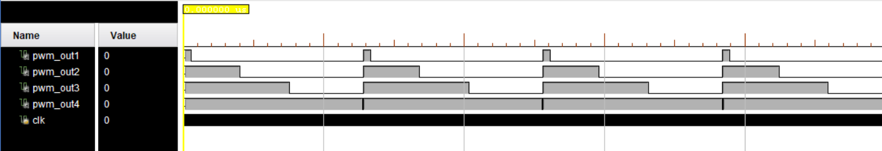
H-Bridge ckt

Slide 10
PWM(Pulse width modulation) signals for speed control

Slide 11

Implementation in “Verilog” HDL Language…

Slide 12
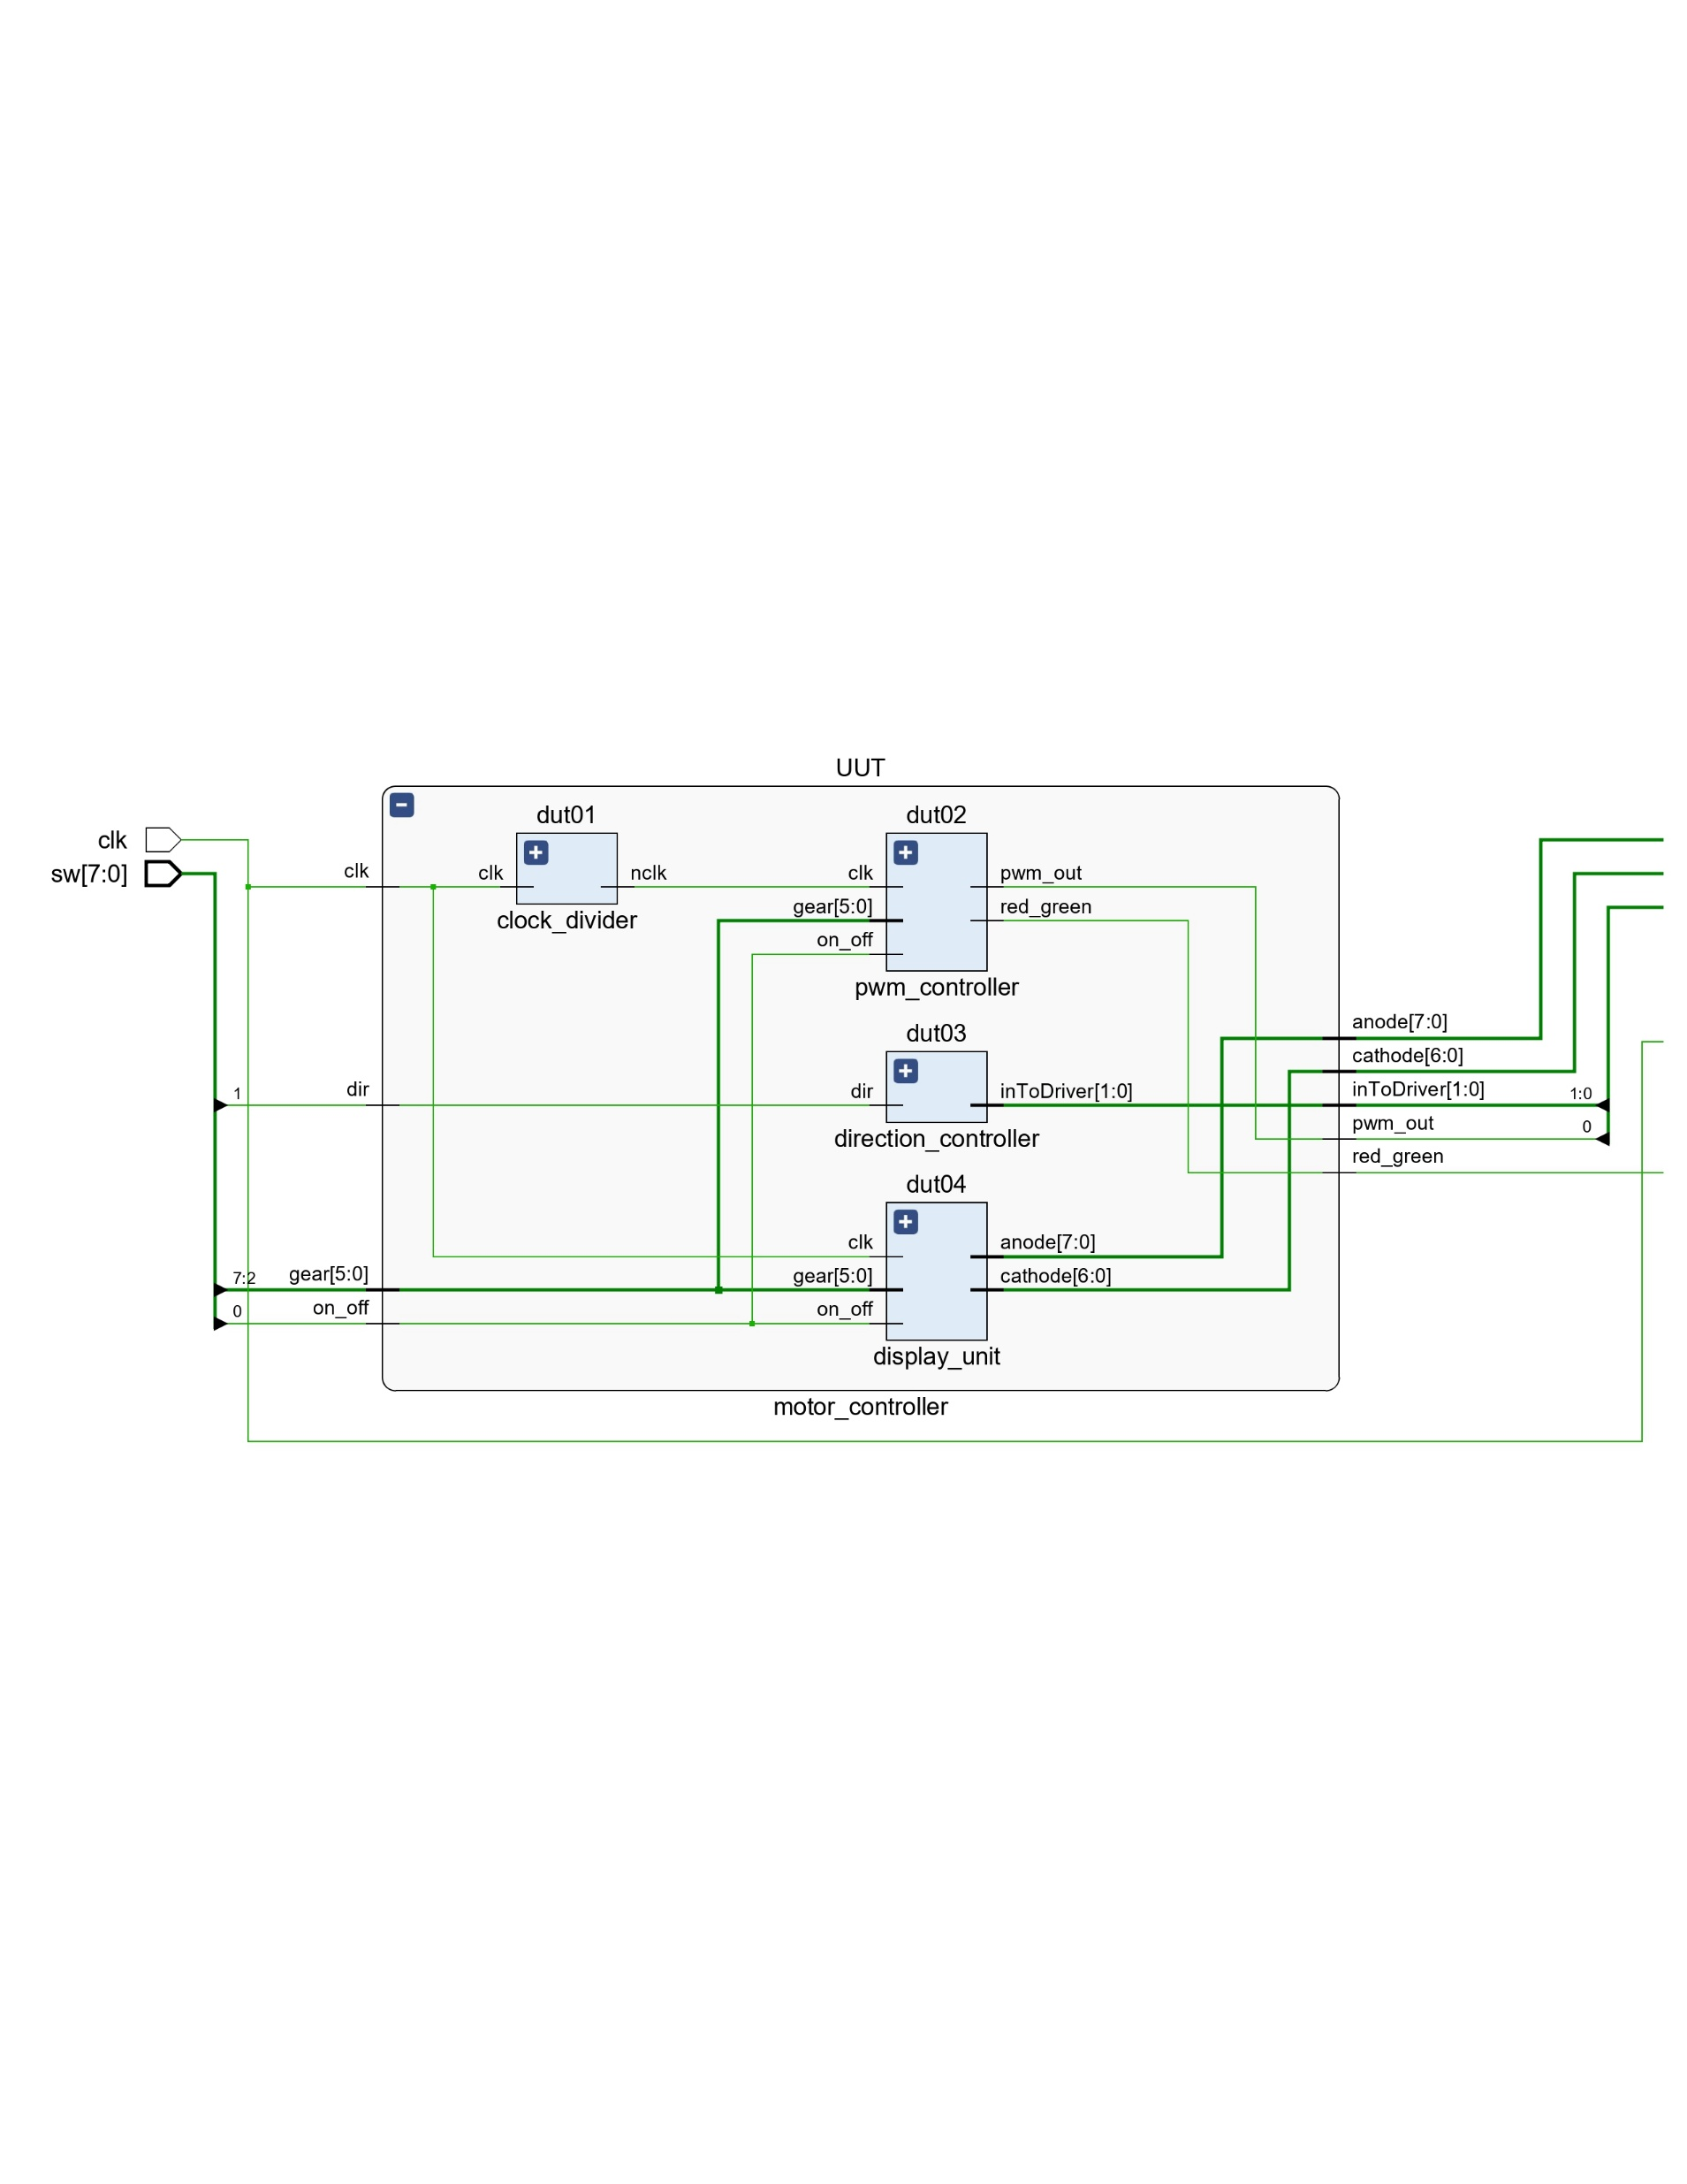

Slide 13
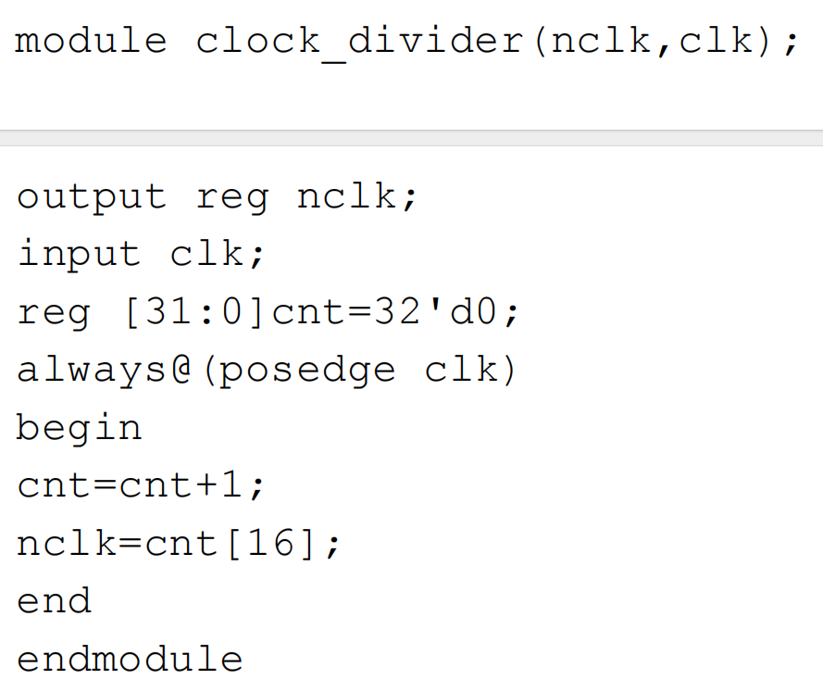
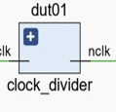

Slide 14
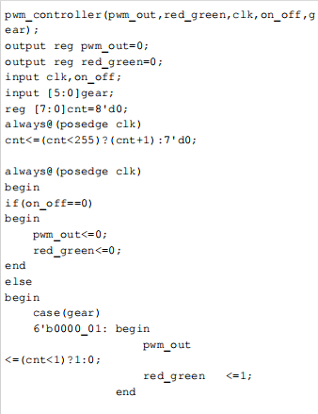
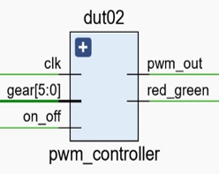

Slide 15
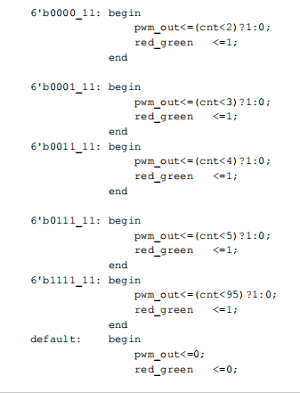

Slide 16
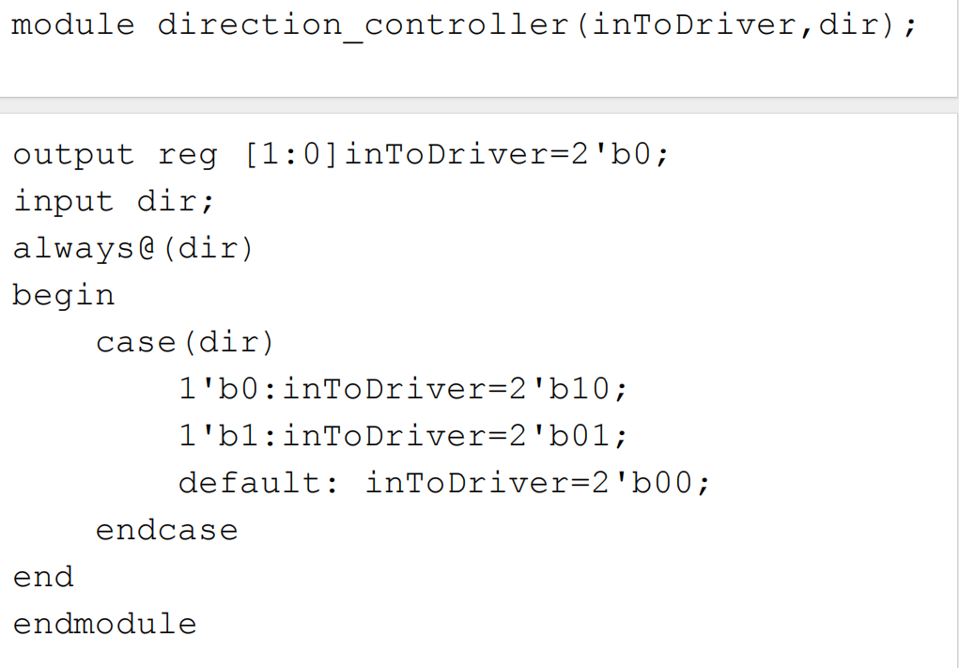
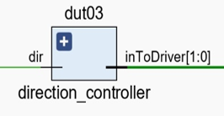

Slide 17
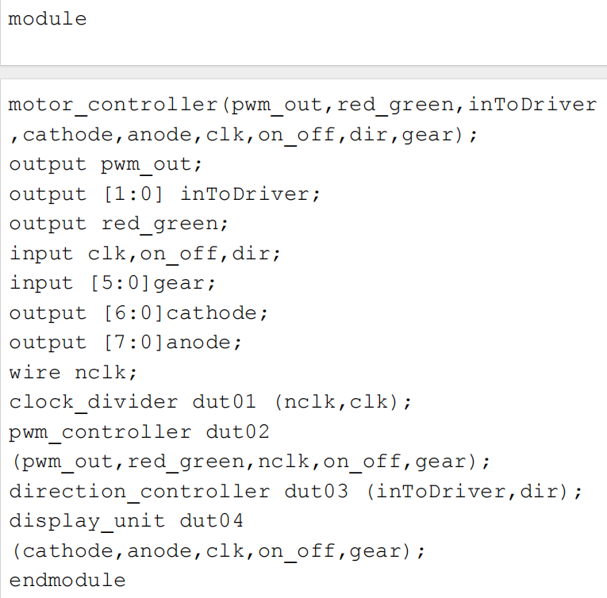

Slide 18
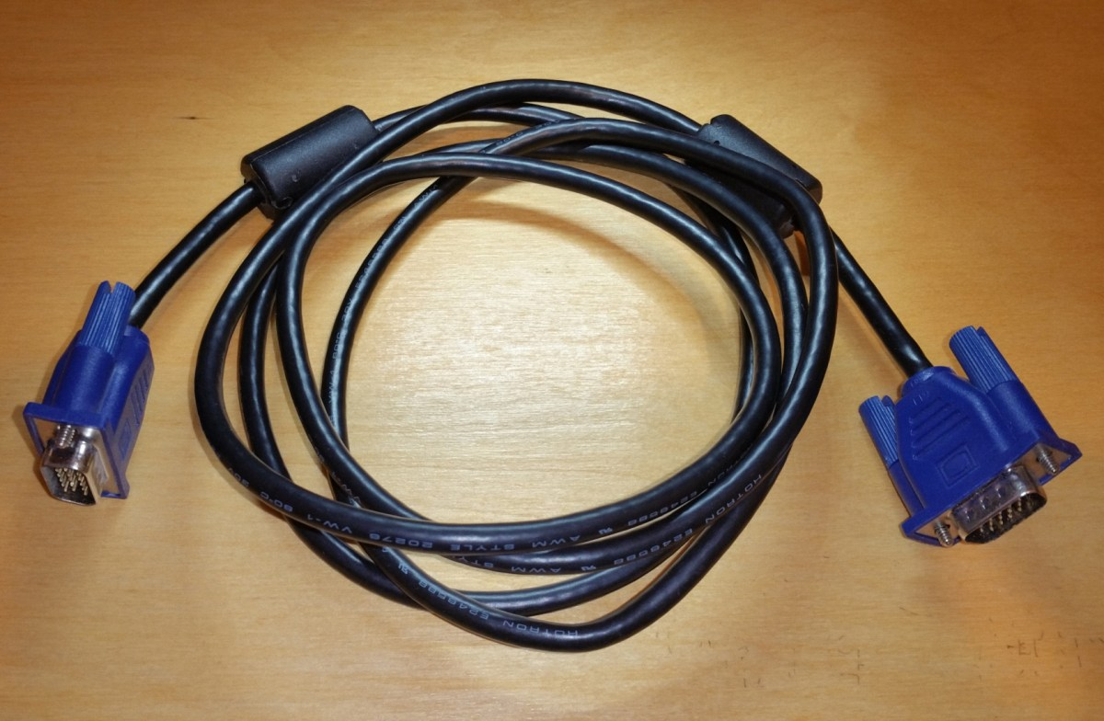

VGA Interfacing…
This Photo by Unknown Author is licensed under CC BY-SA

Slide 19








What exactly VGA is?
VGA stands for Video Graphics Array, a standard for displaying color graphics on a computer monitor.

Slide 20






Slide 21
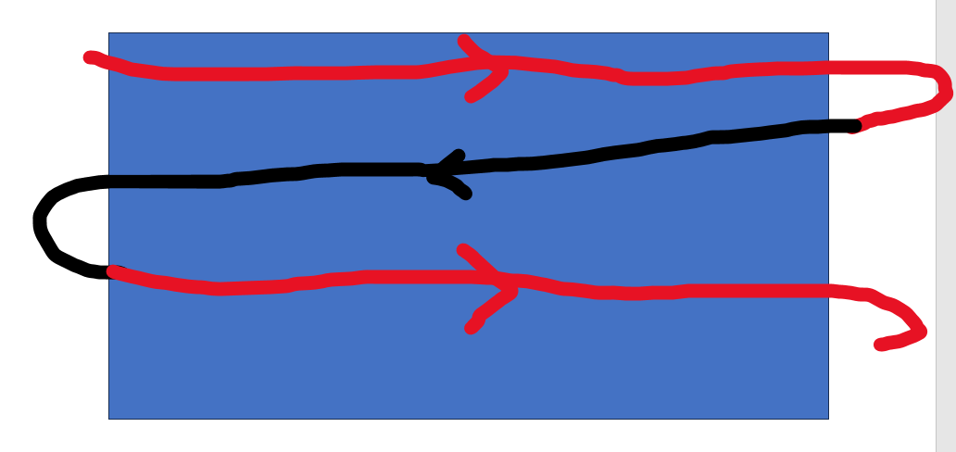
From this we understand the requirement of:-
Horizontal Signal
Vertical Signal

Slide 22
VGA Controller
Resolution (1280x1024)
H_Sync & V_Sync
Red,Blue,Green (RGB Signals)

Slide 23
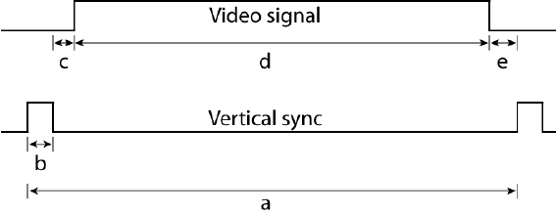

Slide 24
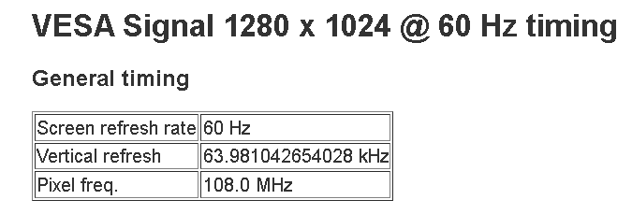
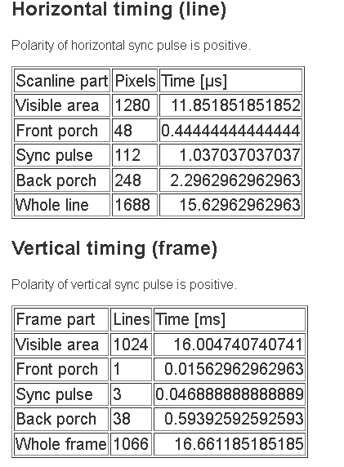

Slide 25
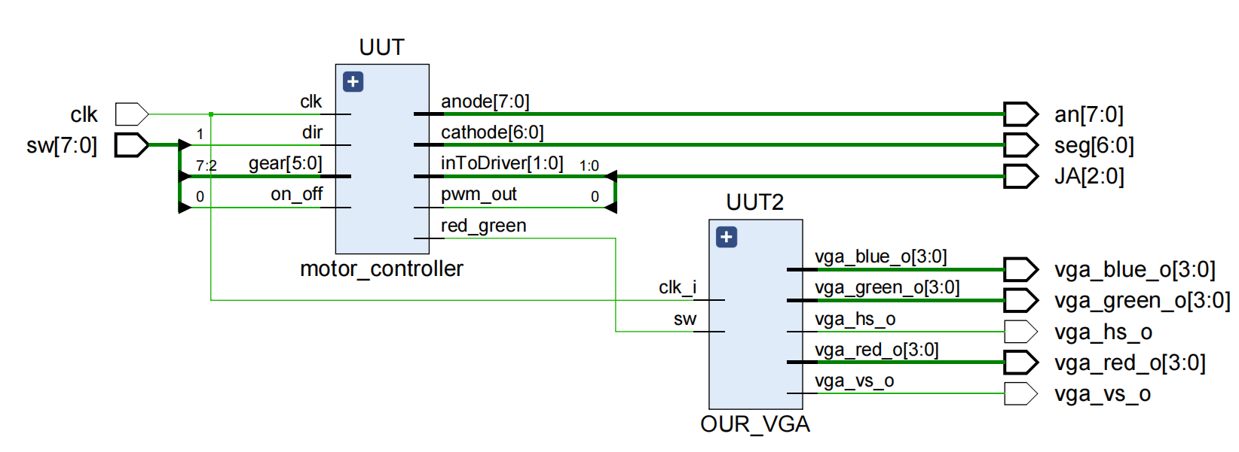

Slide 26
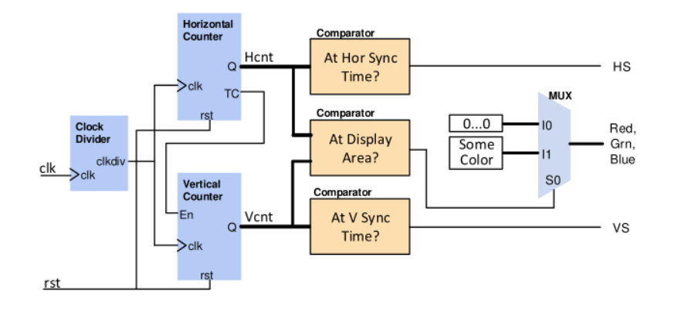
Motor Controller Block Diagram

Slide 27
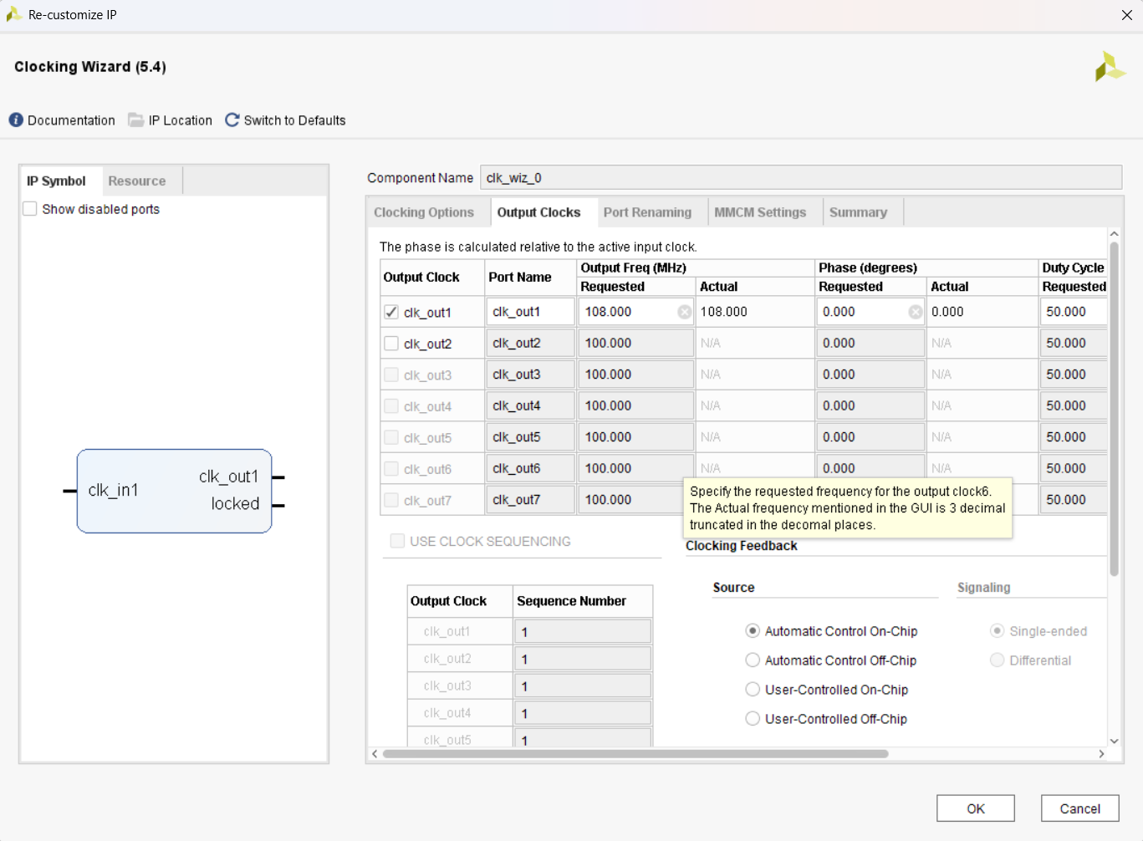

Slide 28
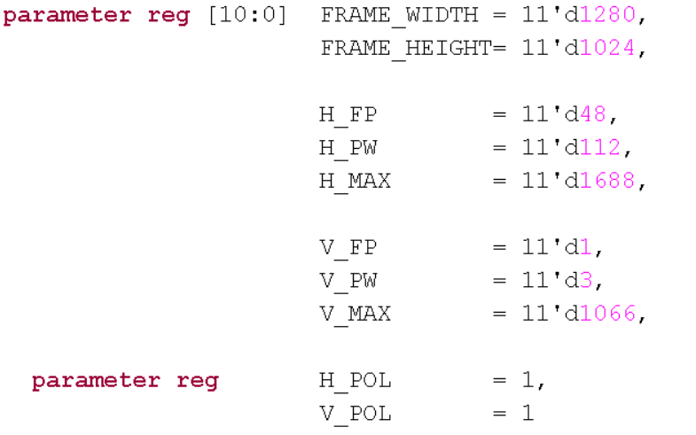

Slide 29
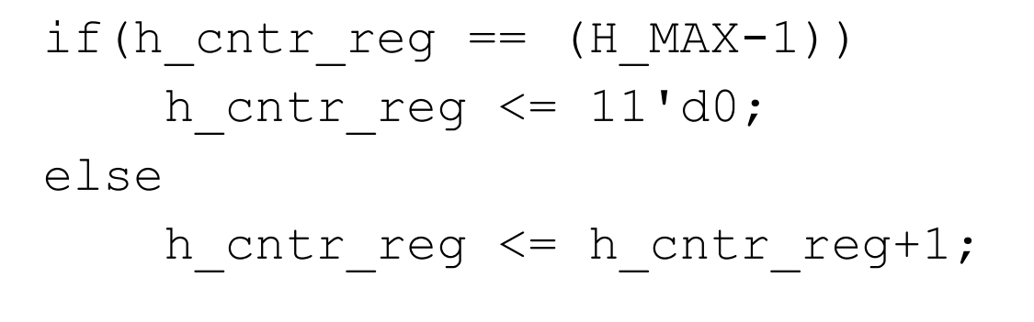

Slide 30
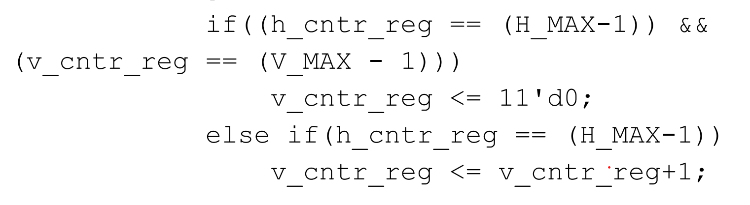

Slide 31
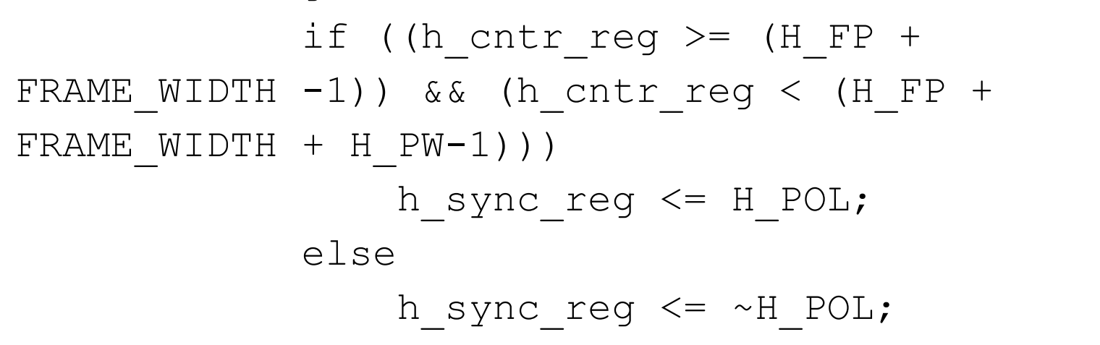

Slide 32


Slide 33
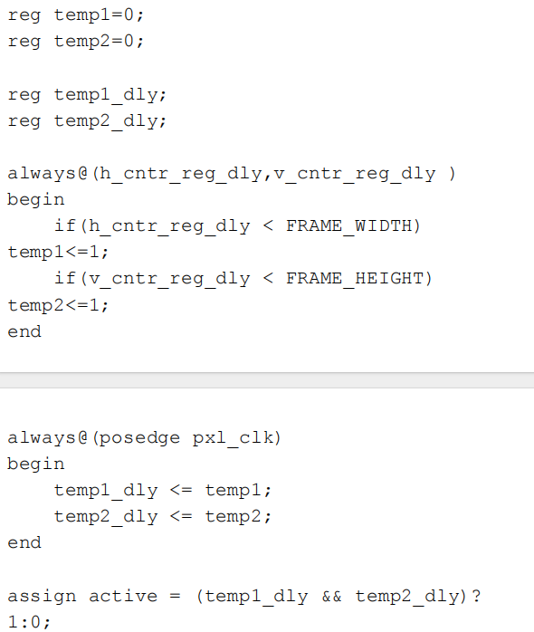

Slide 34
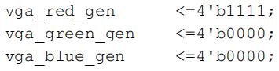

Slide 35
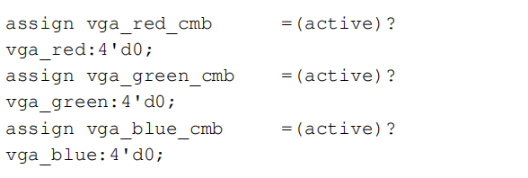

Slide 36
Motor Controller Block Diagram

Slide 37
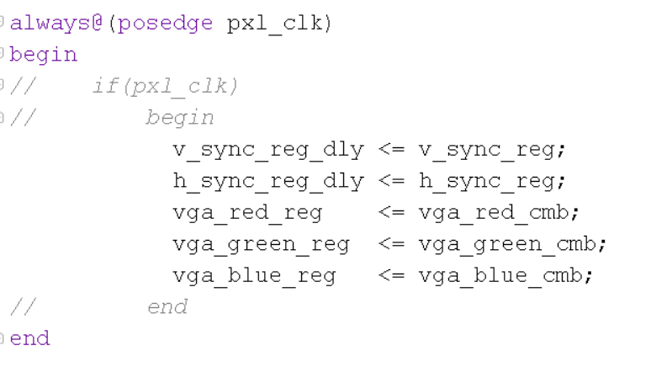
PIPELINING

Slide 38
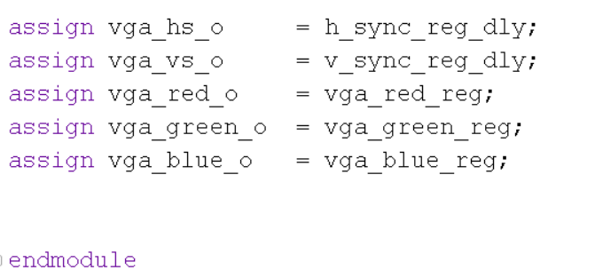

Slide 40
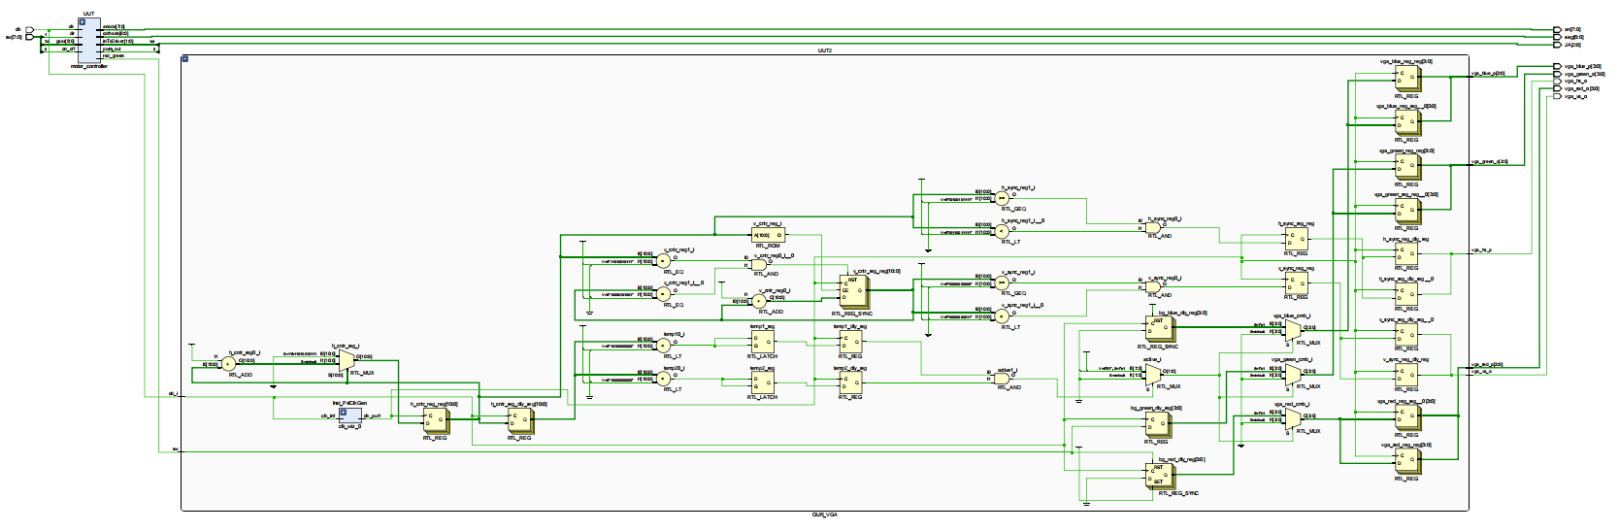

Slide 42

Thank you

